Slide 1
OLAP Operations
Samuel OCEN
E MAIL: - samuel.ocen@mmu.ac.ug
samuel.ocen@student.uonbi.ac.ke
MOB: - +256(0)775 679 505
+256(0)706 109 393

Slide 2
Introduction
OLAP (Online Analytical Processing) is a computer process that enables user to select and extract data from different viewpoints. Slicing and Dicing term is generally used in OLAP databases that presents data to the end user in multidimensional cube format like a 3D spreadsheet (called an OLAP cube). The OLAP cube comprises numeric facts called measures which are categorized by dimensions.

Slide 3
Slicing and dicing
Slicing and Dicing refers to a way of segmenting, viewing and comprehending data in a database. Large blocks of data is cut into smaller segments and the process is repeated until the correct level of detail is achieved for proper analysis.
Large blocks of data is cut into smaller segments and the process is repeated until the correct level of detail is achieved for proper analysis. Therefore, slicing and dicing presents the data in new and diverse perspectives and provides a closer view of it for analysis. For example, a report is showing annual performance of a particular product. If we want to view the quarterly performance, we can use slicing and dicing strategy to drill down to the quarterly level.

Slide 4
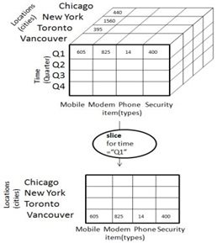
Slicing
Slicing refers to selecting a subset of the cube by choosing a single value for one of its dimension and creating a smaller cube with one less dimension.
In this diagram, the slice is performed for dimension “time” using the variable “Q1” (criteria time). It generates a new cube with 2 dimensions. Thus slice operation produced a sliced OLAP cube by enabling the user to choose specific value for one of its dimension.

Slide 5
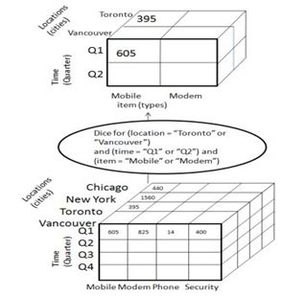
Dicing
Dicing on the other hand generates a subcube by picking two or more values from multiple dimensions of the cube. The cube is rotated independent of its dimension.
In the above diagram, the dice operation is based on the following selection criteria involving all the three variables:
Location = “Vancouver” or “Toronto”
Time = “Q1” or “Q2”
Item = “ Modem” or “Mobile”
Thus dicing and slicing allows detailed analysis of data from different angles.

Slide 6
Difference Between Slice and Dice in Data Warehouse
Definition
Slice is the act of picking a rectangular subset of a cube by choosing a single value for one of its dimensions, creating a new cube with fewer dimensions. Dice is the act of producing a subcube by allowing the analyst to pick specific values of multiple dimensions. Thus, this describes the main difference between slice and dice in data warehouse.
Usage
Another difference between slice and dice in data warehouse is their usage. Slice is used to select one dimension from a given cube and to provide a new subcube. Dice is used to select two or more dimensions from a given cube and to provide a new subcube.
Conclusion
Slice and dice are two operations that are used in OLAP strategy in data warehouses. The main difference between slice and dice in data warehouse is that the slice is an operation that selects one specific dimension from a give data cube and provides a new subcube while the dice is an operation that selects two or more dimensions from a given data cube and provides a new subcube.

Slide 7
Drill up and drill down
Data exploration can be done in a data warehouse in two ways: drill down and drill up. In general, a drill down allows you to examine a metric at a lower level of detail, whereas a drill up allows you to examine a metric at a higher level of detail.
In data warehousing, drill-down and drill-up are operations used to navigate through the data. Drill-down is the process of moving from a higher-level of data to a lower-level. This is done by adding more details or breaking down the data into smaller pieces. Drill-up is the opposite of drill-down; it is the process of moving from a lower-level of data to a higher-level. This is done by aggregating the data or removing details.

Slide 8
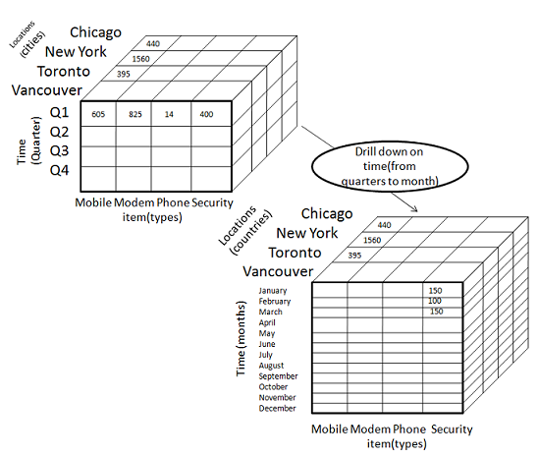
Drill-Down
Drill-down is the reverse operation of roll-up. It is performed by either of the following ways −
By stepping down a concept hierarchy for a dimension
By introducing a new dimension.
The following diagram illustrates how drill-down works −
Drill-down is performed by stepping down a concept hierarchy for the dimension time.
Initially the concept hierarchy was "day < month < quarter < year."
On drilling down, the time dimension is descended from the level of quarter to the level of month.
When drill-down is performed, one or more dimensions from the data cube are added.
It navigates the data from less detailed data to highly detailed data.

Slide 9
Drill within and drill across.
Read about this

